Slide 1
Owner’s View of Data
24
Forwarded
to SBA
from SBDC
Client Fills out and Submits
Application
Current System
Action Report
Information
Action Report
Folder for Client
Validated and Verified SBA Form
Client Interviews with Counselor
Notes:
Redone 4/28/09
1

Slide 2
Owner’s View of Data Narrative
25
The data is implemented in an online application process and delivered to the appropriate recipients. The data that is involved in the RelateKX application is as follows:
The metrics of the resume portfolio are a necessity in order for the system owners and faculty-staff users to accurately conclude whether the system is adding the intended value of helping facilitate student-recruiter relationships. In order to fulfill the system requirements one needs to be able engage in the use of emails, schedules, videos, images, and portfolios in the proper ways. By facilitating the use of this data, recruiters, faculty, and staff will be able to have proper interactions with students and their portfolios. The benefit of incorporating all of this data into system requirements and features is that it will allow relationships to develop between the student and the recruiter seeking a new employee. This will then lead to the application solidifying its value by showcasing the richness in experience as well as education of the students at C&BA.
The client fills out and submits the application (Form 641) about themselves and their business to the SBDC. The application is verified and validated by the counselors at the SBDC. After being verified by the counselor, the client is interviewed by the counselor. After the interview, the counselor fills out an Action Report and files it in a folder with the client’s application and other documents. If the client is accepted, then their information is forwarded to the SBA.
Notes:
Last updated 4/28/09
2

Slide 3
Owner’s View of Process
26
Current System
Client Registration
Fill Out SBA form
Fill Out Action Report
Store Reports
Client Manually picks Up Form At Local SBDC
Counselor Manually Picks Up Action Report
Counselor Creates A New Folder For Client
Client Manually Fills Out The SBA Form
Counselor Fills Out Report Based Off
of initial Meeting
Counselor Puts Form and Reports in Folder
Client Returns Completed Form To Counselor
Counselor Verifies
and Validates the
form is complete
Counselor Places In Filing Cabinet
Counselor Reviews and Validates Form Completion
Notes:
Last modified 4/28/09
3

Slide 4
Owner’s View of Interfaces Narrative
29
The current system is initiated when the client registers themselves and their business by submitting Form 641 to their local SBDC.
The SBA Form 641 has to be filled out by the client. The client has to visit their local SBDC and pick up the application. After completion of the application, the client must return the application to their local SBDC. Upon receipt of the application, a SBDC counselor reviews and validates the application. If the application is submitted to the incorrect SBDC, the client will be notified and the application will have to be forwarded to the appropriate SBDC.
After reviewing and validating the application report, the counselor picks up an Action Report. After setting up a meeting and interviewing the client, the Action Report is completed by a SBDC counselor.
The client’s application and the Action Report are ready to be stored in a folder for filing. The SBDC counselor labels a new file folder for the client. Then the client’s application and Action Report about the client are placed into this folder and stored into a filing cabinet.
Notes:
Last modified 4/28/09
4

Slide 5
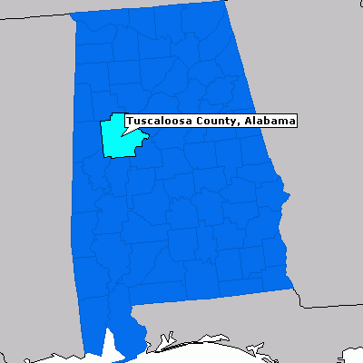
Owner’s View of Geography
30
The star represents the location of The University of Alabama
Notes:
5

Slide 6
Owner’s View of Geography Narrative
31
The previous image displays the owner’s view of geography which exhibits the location where the data originated from and where the data is being used. The overall map displays the state of Alabama and the county in which this data will be effected. The highlighted county is Tuscaloosa County and within Tuscaloosa County is The University of Alabama. The SBDC primarily works and has offices in Tuscaloosa, Alabama. The data exemplified in this project are primarily designated for The University of Alabama and may spread state-wide and eventually nationally.
Notes:
6

